Slide 1
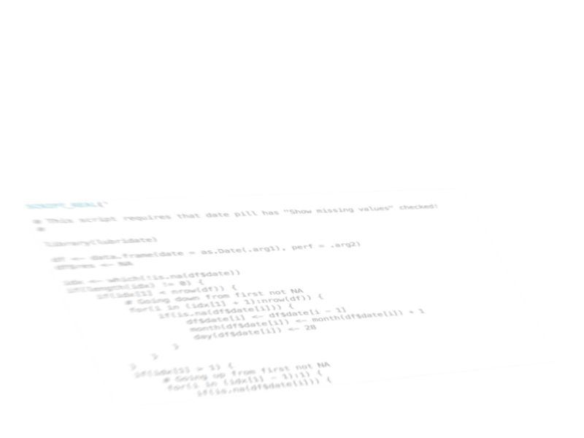
Tableau + R Ericsson Data Visualisation Day, Kista, Sept. 26th, 2016
Mariusz Musiał
Ericsson Ericpol
Notes:
9/12/162012-02-03
1
2012-02-03
1

Slide 2
Agenda
Short peek into a dataset
Tableau – R connection (this will be short, too)
Tableau – R Data Interchange
Use case 1: Data Smoothing
Use Case 2: Rolling Average and Median in Time Domain

Slide 3
R+Tableau data interchange
R calculations are encapsulated as calculated fields
Those are table calculations -> set proper „compute using” value
In most cases you want unaggregated data sent to R -> uncheck analysis -> aggregate results
From R script return either scalar or vector of lenght equal to input data vector
Attention with „show missing values” in date pills -> na is sent to R for each tableau-generated date

Slide 4
Linear/loess smoothing
The plan:
Use lm or loess R function, depending on a parameter
Calculate the fitted line and lower and upper CI intervals
Concatenate the 3 values into one string
Create 3 calculated fields to extract fit, lower and upper ci
Display the 3 resulting lines superimposed on data scatterplot
Extra: allow setting ci level by a parameter
Extra: allow setting of loess span by a parameter

Slide 5
Rolling average/median
The plan:
Partition data by month showing missing values (in tableau)
Reconstruct missing months in the input data
Construct vector of ending dates for each 12m period
Construct vector of starting dates for each 12m period
Iterate over each 12m period and:
Subset performance measure to select only given period
Calculate average or median, depending on a parameter
Assign the result to each date of the period’s ending month
Return the result

Slide 6
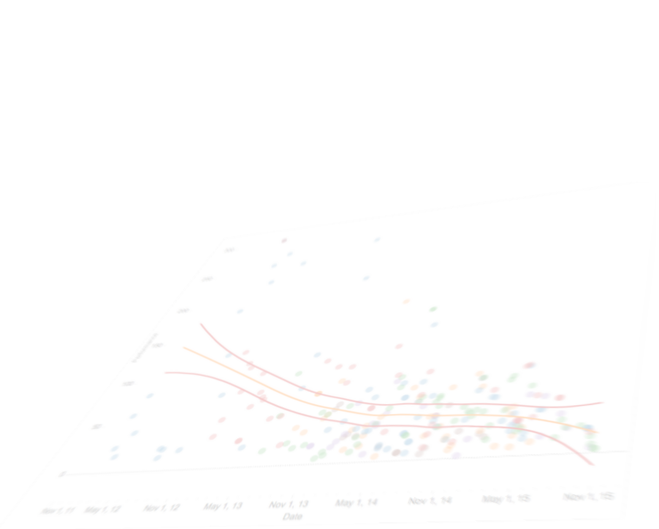
References
Rserve Installation: link
Data smoothing code and Tableau + R inspiration from R-bloggers post

